Slide 1
Binary Image classification using CNN model
Subject: Data 606(Capstone Project)
Professor: Chaojie Wang
Presentor: Yaswanth Reddy Annapureddy

Slide 2
PROBLEM STATEMENT
Solid waste management is a pressing global issue that poses serious threats to the environment and public health. It is produced by various human activities, including residences, businesses, farms, and industries. If ignored, it may lead to a threat to the ecosystem. One method of managing solid waste is through segregation, where different types of solid waste are sorted to dispose of it properly. The problem, however, is how to manage waste that can no longer be used. Many countries have waste-related issues because waste production rates are higher than management efforts. Often, people dispose of mixed waste in dumpsites due to a lack of awareness about the effects of improperly segregated garbage. Biodegradable waste, such as kitchen garbage, agricultural waste, human and animal waste, can be broken down biologically by live microbes. On the other hand, non-biodegradable waste, such as plastic, metal, and glass, cannot be broken down biologically, making their management crucial in the modern-day. To categorize waste into biodegradable and non-biodegradable types, machine learning models, including TensorFlow and convolutional neural networks, can be used. Over 150k images of biodegradable and non-biodegradable items have been taken to train the model. Proper waste management through technology and solutions is necessary to reduce the adverse effects of waste on the environment and public health. Therefore, it is crucial to raise awareness and educate the public on the importance of proper waste management.

Slide 3
OBJECTIVE
Our aim is to classify the waste with automation as a trained model at its base to quickly separate both so that they can be sent separately to either recycling or dump accordingly.
We aim to regularize the classification of trash for environmental purposes.
Cities and metropolitan areas can implement this model to collect data on how citizens are using the recycling facilities, and how to improve the service.
It can be used in automatic trash collection robots, to correctly dispose of the waste accordingly.
Proper waste segregation can lead to cost savings in waste management by reducing landfill disposal costs and promoting recycling and reuse of materials.
To reduce health hazards associated with waste management, such as exposure to hazardous chemicals and toxins.
To reduce the amount of waste sent to landfills, which can help reduce the pressure on limited landfill space and extend the life of existing landfill sites.

Slide 4
SOLUTION
I have taken a total of 75000 images in each category and trained a CNN model with Keras to test the accuracy and efficiency of the model.
I have made a custom CNN model with “RELu” activation function and VGG 16 model for classification.
To make the model well-suited for real-time or near-real-time applications, such as sorting trash on a conveyor belt or in a waste processing plant.
Making the model to process large volumes of images, making them suitable for processing large amounts of waste in municipal or industrial waste management facilities.
To provide objective classification of waste, reducing the risk of human error or bias in the classification process.

Slide 5
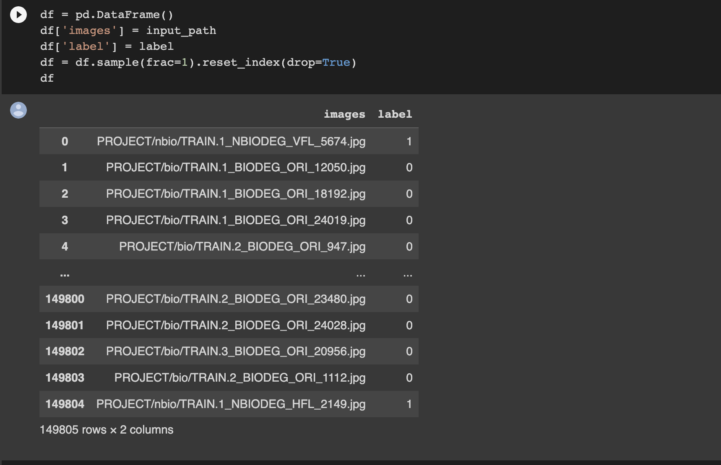
DATASET
Our dataset contains a total of more than 1,40,000 images in both bio-degradable and non-biodegradable materials, sourced from the Kaggle open datasets and web scraping.
Link for the dataset: Dataset. The dataset showing the number of images and path for the images is below:

Slide 6
DATA COLLECTION AND MODEL MAKING
The study's data set consists of 150K photos of trash divided into two categories: "biodegradable" and "non-biodegradable." It is retrieved from the open-access Kaggle database.
Six categories make up the dataset: trash, glass, paper, cardboard, plastic, and metal.
The non-biodegradable class used some of these images that were gathered from the six categories, and the biodegradable class used images of typical food waste.
Data Augmentation:
The performance of an algorithm improves with the amount of data it has access to. To adequately train the machine learning models, the original dataset's relatively limited number of photos needed to be augmented.
Data augmentation is a way to increase the dataset's size and the model's precision. By generating fresh data from the base data, data augmentation improves data.
Simply applying random changes to our images will improve the generalizability of our model. Compressions, rotations, stretches, and even color shifts are examples of these transformations.
We have done this using ImageDataGenerator from tensorflow.keras.preprocessing.image.

Slide 7
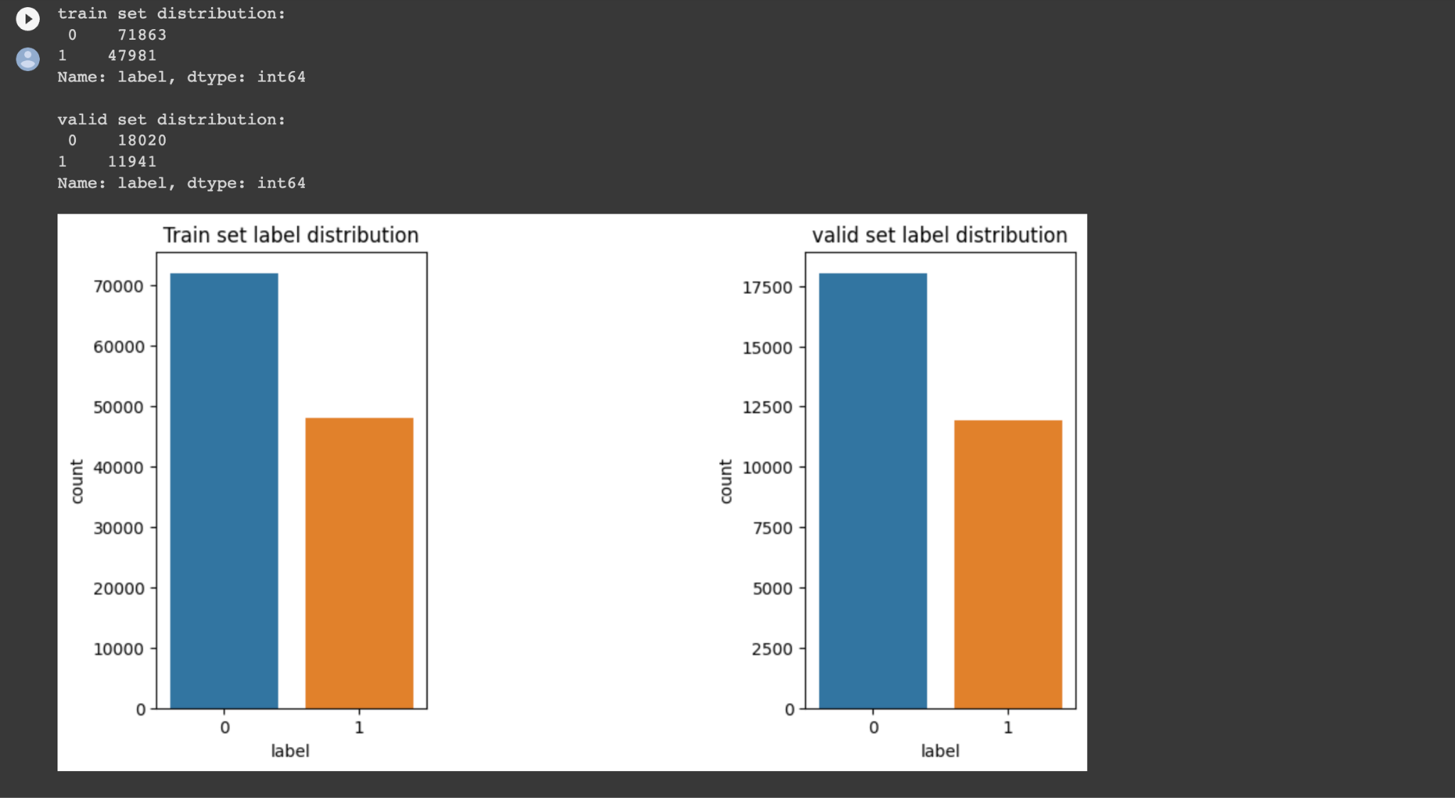
Train and Valid set distribution
The images for train and test validation is as below:

Slide 8
Training and Testing
This is where the data is fit into the training set. Due to the callback's monitoring of the validation set, the validation set is also passed.
If the loss does not improve after two epochs as specified in the EarlyStopping callback, the training process will be terminated by the callback. In this scenario, you can define a large number of epochs.

Slide 9
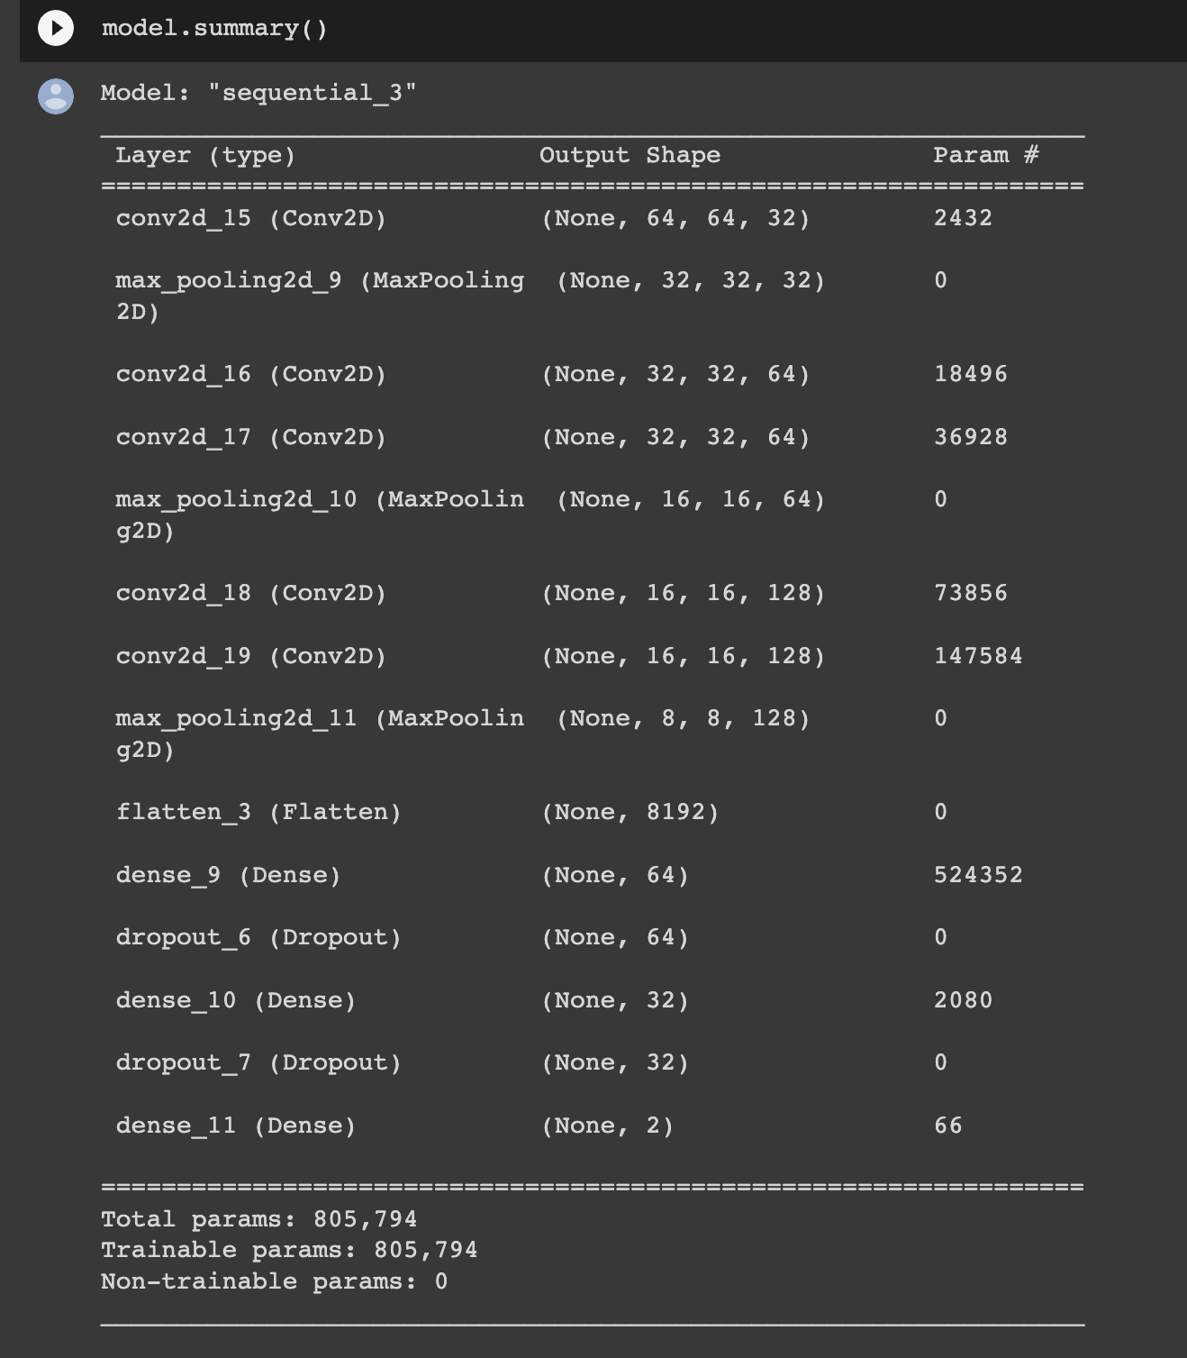
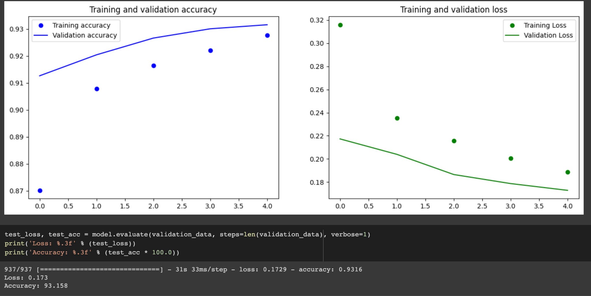
Results for Custom CNN.

Slide 10
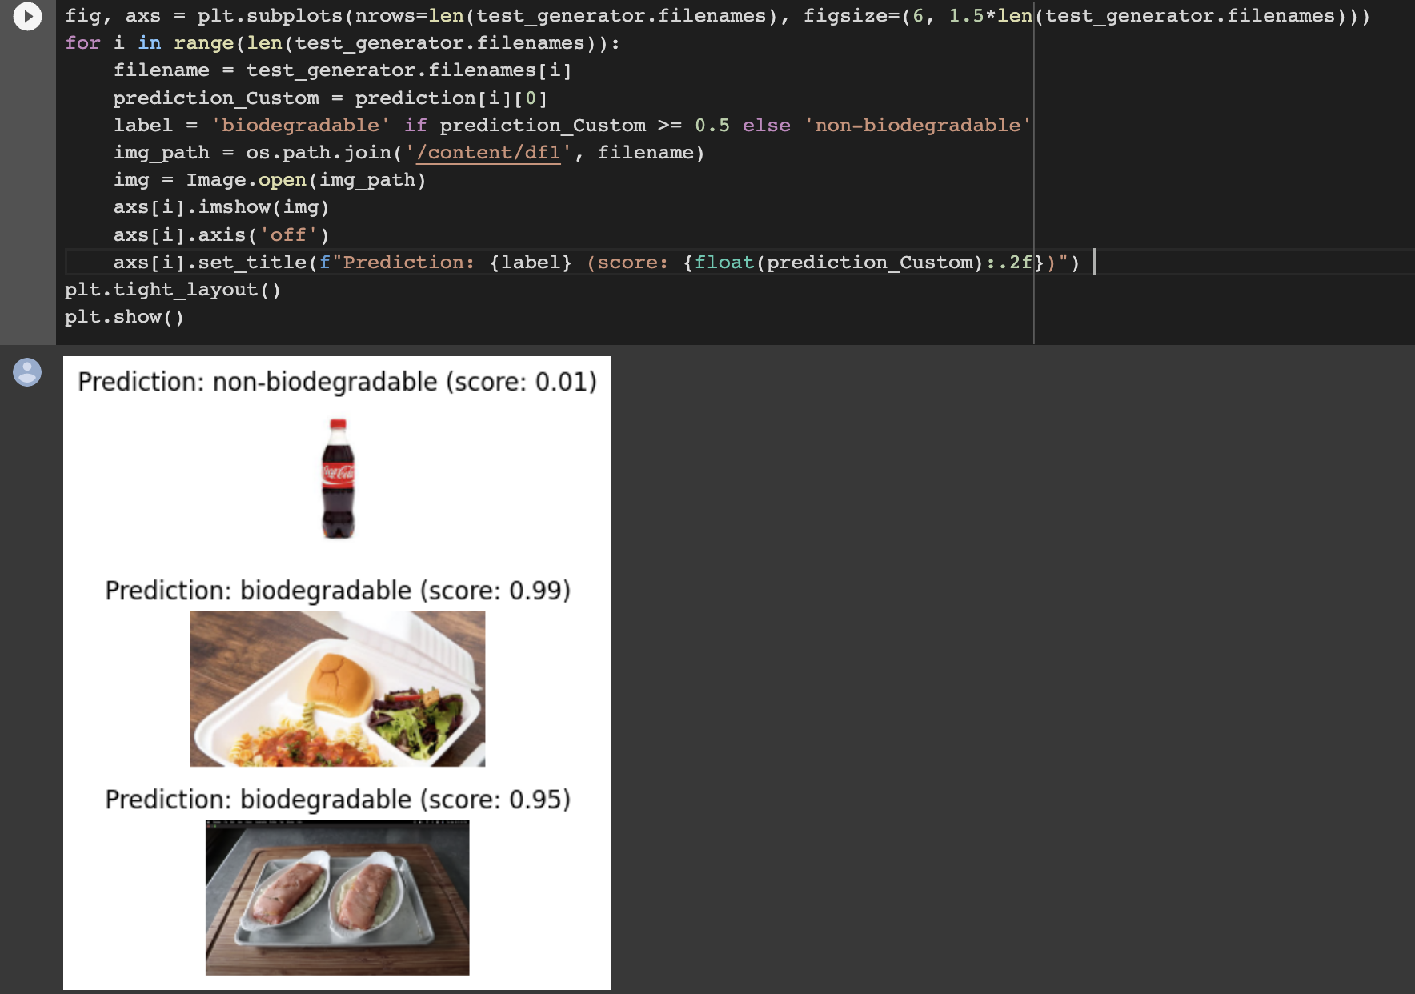
Predictions for Custom CNN
The predictions for Custom CNN is as below:

Slide 11
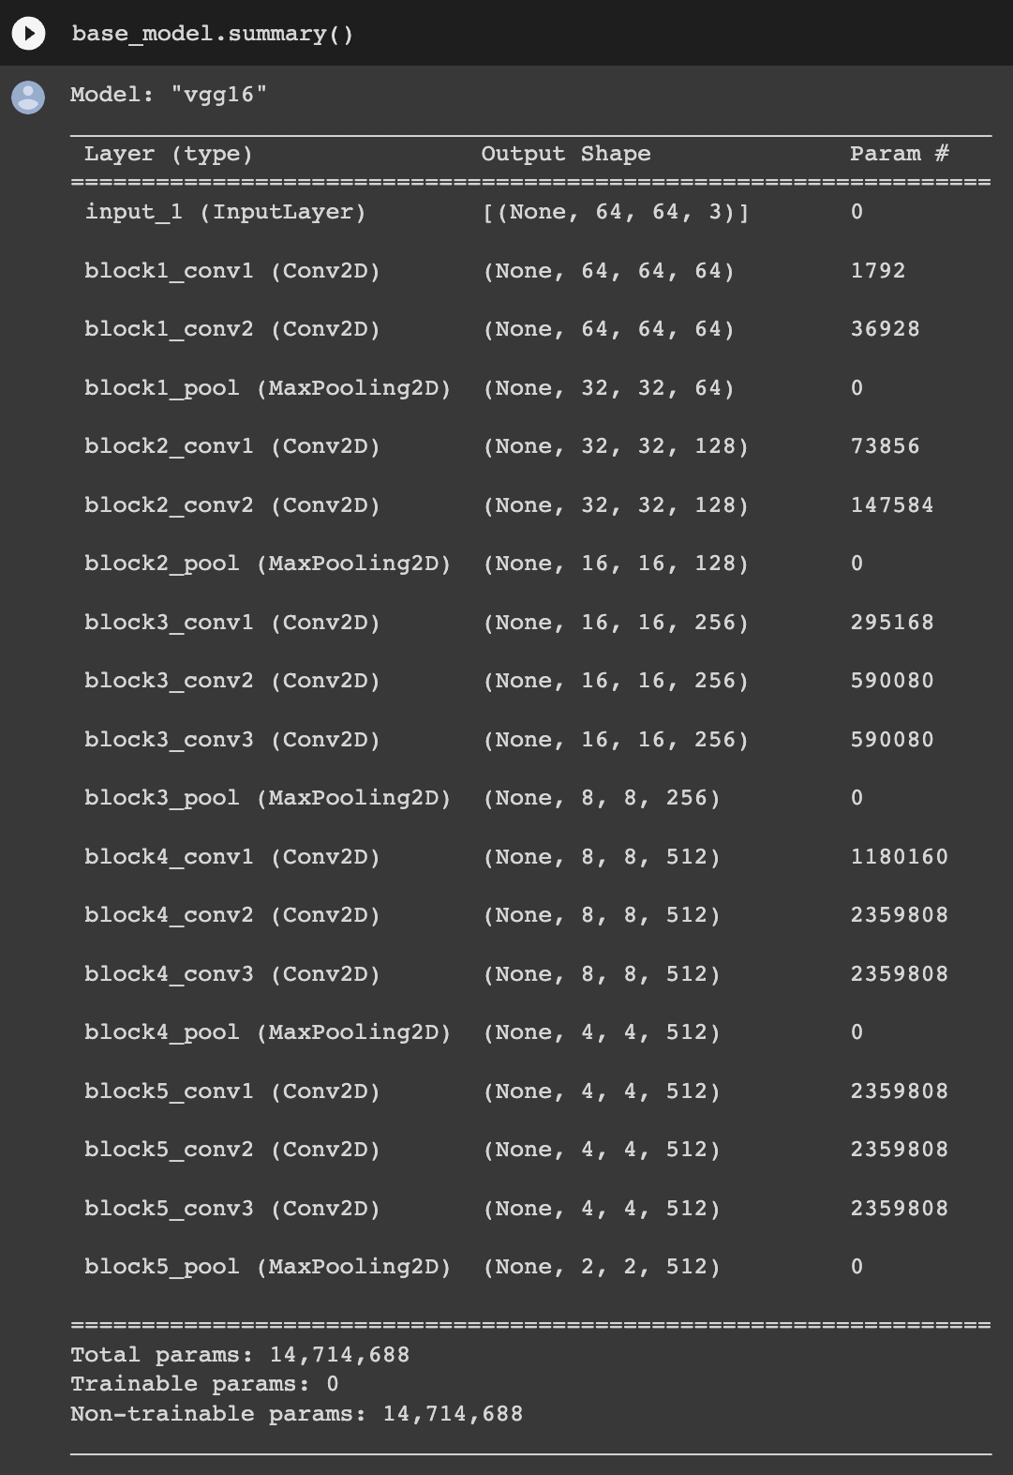
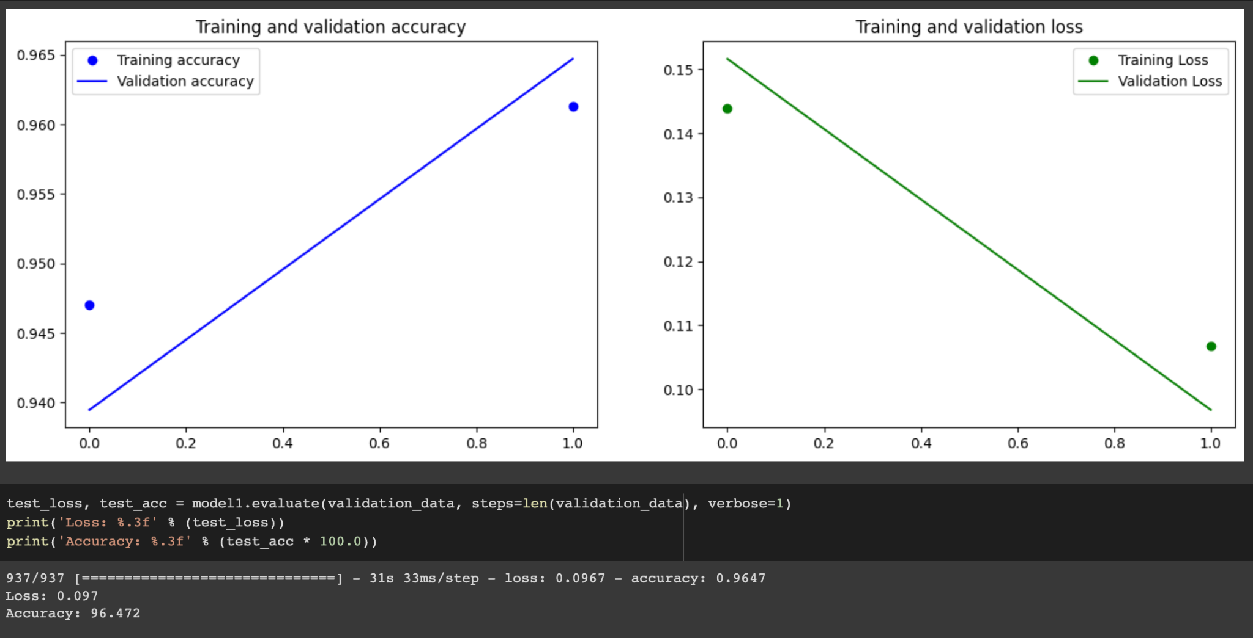
Results for VGG16 model

Slide 12
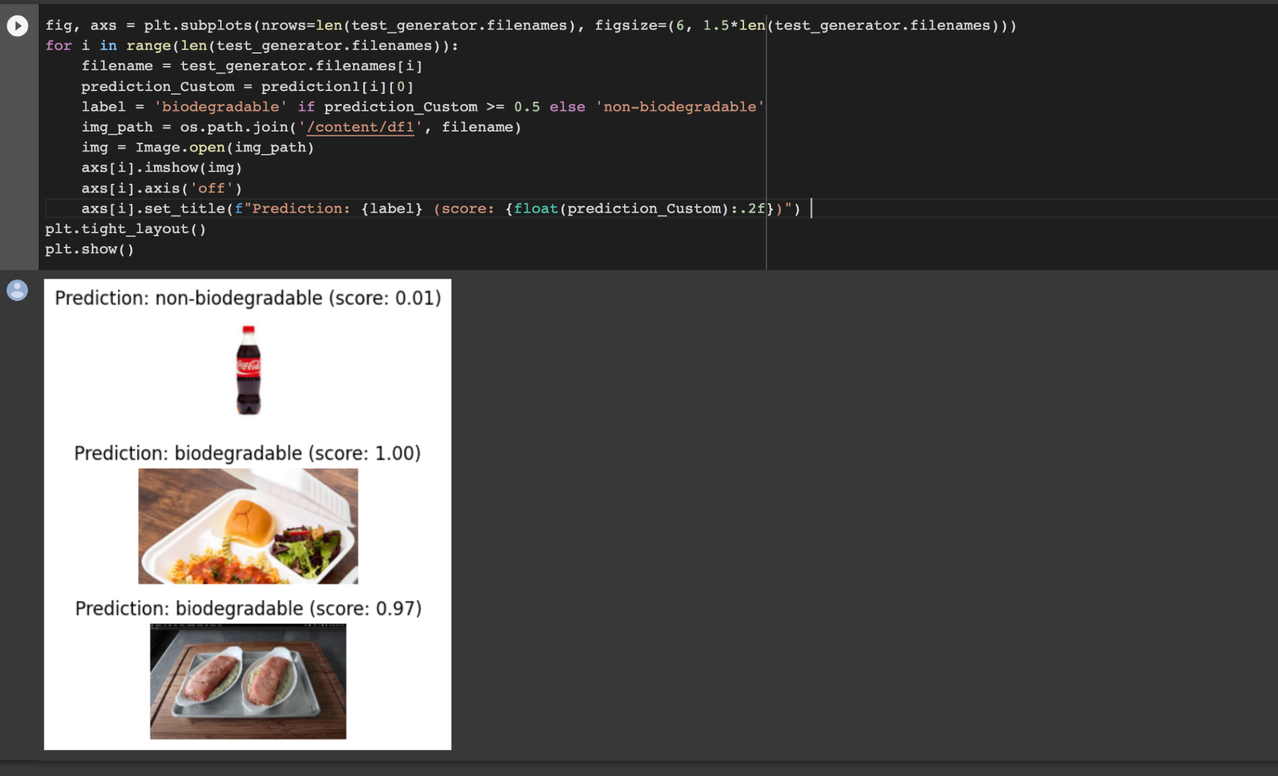
Predictions for VGG 16 model
The predictions for VGG-16 model is:

Slide 13
Impact of the project
If the model is used in AI-powered trash collectors or classifications, we can save millions of trash from getting landfilled.
If the bio and non-biodegradable materials are mixed with each other, it's hard to classify and recycle the non-degradable. So if they are classified properly, we can save tons of trash from going to landfills.

Slide 14
Reference
Hanbal, I. F., Ingosan, J. S., Oyam, N. A. A., & Hu, Y. (2020). Classifying Wastes Using Random Forests, Gaussian Naïve Bayes, Support Vector Machine and Multilayer Perceptron. IOP Conference Series: Materials Science and Engineering, 803(1), 012017. https://doi.org/10.1088/1757-899x/803/1/012017
Bhansali, R. (2021, October 11). An Overview of Non-Biodegradable Waste Management and Solutions. Organica Biotech. https://organicabiotech.com/an-overview-of-non-biodegradable-waste-management-and-solutions/
Derrick Mwiti, (2021, February 23). How to build CNN in TensorFlow: examples, code and notebooks | cnvrg.io. https://cnvrg.io/cnn-tensorflow/
whoisslimshady. (2021, March 14). Introduction to Convolutional Neural Network With Tensorflow and Keras. Geek Culture. https://medium.com/geekculture/introduction-to-convolutional-neural-network-with-tensorflow-and-keras-cb52cdc66eaf
Atik, I. (2022). Analysis of Biodegradable and Non-Biodegradable Materials Using Selected Deep Learning Algorithms. International Journal of Computer (IJC), 43(1), 48–59. https://ijcjournal.org/index.php/InternationalJournalOfComputer/article/view/1939/712

